Slide 1
FreeFlow: High Performance Container Networking

Slide 2
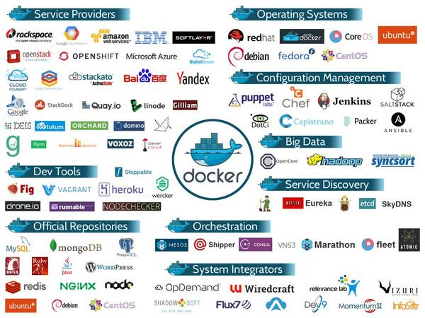
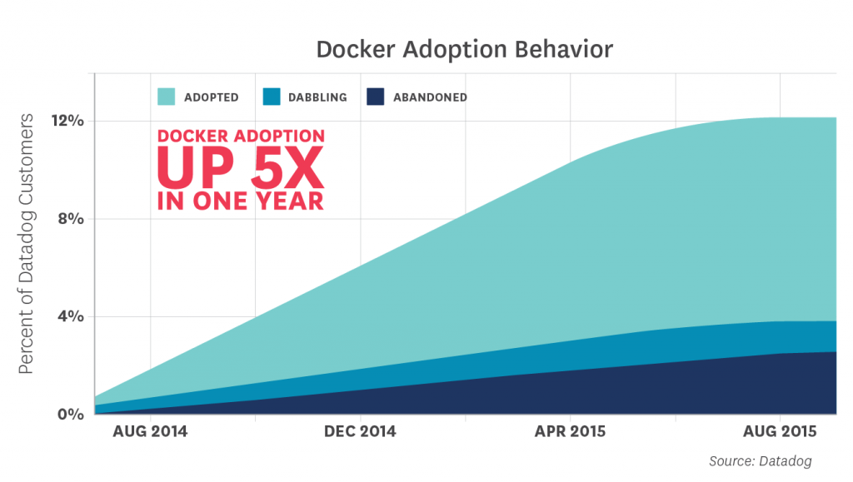
Container is becoming tremendously popular
Reshaping cloud
Rapid increase

Slide 3
What is container?
cgroups
namespace
container
image
What can access
What can be seen

Slide 4
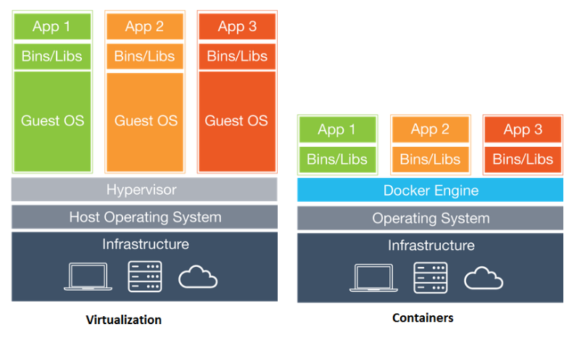
Container vs. VM
Containers are much more light weight

Slide 5
Container vs. Process
Application
Application
Application
Bins/Libs
Bins/Libs
No OS can shared Bins/Libs
Process not portable
Containers are portable

Slide 6
Why is container so popular?
Lightweight
Portability
Isolation

Slide 7
A booming of startups
Portworx. Simplify container deployment using SDN. $8.5 million.
Hedvig. Software-defined storage for Docker containers. $30.5 million.
Sysdig. Container monitoring. $28 million.
Aviatrix. Networking solutions for containers. $10 million.
Codefresh. Docker deployment platform.
Virtuozzo. Storage and other services for Docker containers.
Weaveworks. Provides a container management platform. $20 million.
ClusterHQ. Container management and data storage solutions. $18 million.
Datadog. Monitoring solution for Docker environments. $147.9 million.

Slide 8
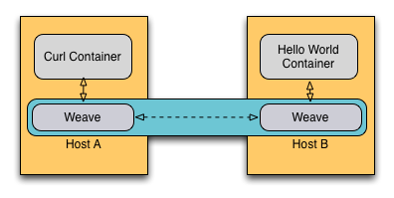
The status of container networks
Container
Container
bind to host IP/port
Host
Overlay

Slide 9
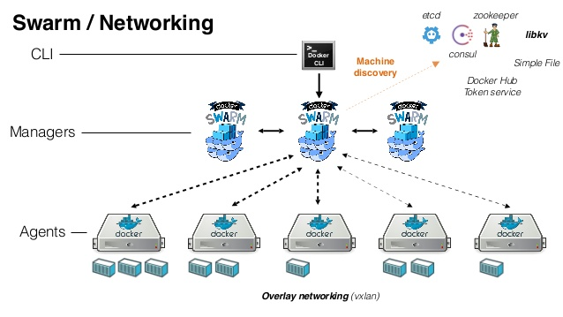
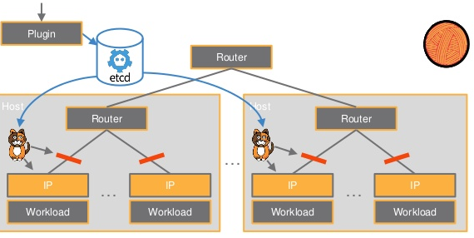
Popular overlays
Docker Swarm
Weave
Calico

Slide 10
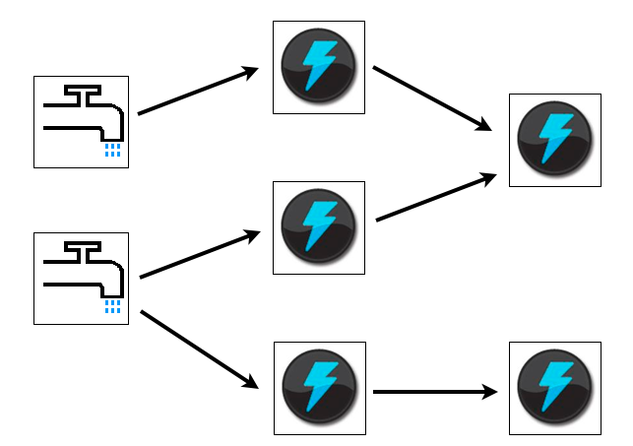
Container applications requires high network performance
Storm Streaming Processing

Slide 11

Container

Slide 12
